Slide 1
Ahmet Adnan Saygun

Slide 2
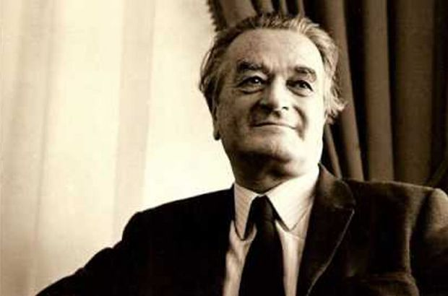
He was born in september 7, 1907 in Izmir. He passed away in january 6, 1991 at the age of 83 in Istanbul, Turkey.
He was a Turkish composer, musicologist and writer on music.
His dad who was a mathematics teacher and scholar of religions and literature taught him English and French as well as a world religions at an early age.
He started playing the piano, the Ottoman Short-Necked lute and the oud at an early age. He quickly found his passion writing music at the age of fourteen.

Slide 3
There were frequent concerts given by the Ottoman Military Bands. Performances of western works by chamber music ensembles at the time and this influenced Saygun to start his first music lessons in elementary school.
Saygun was able to translate the music section of the French Grande Encyclopedie into a music encyclopedie in Turkish.
In highschool, he continued his music lessons with lessons in school as well as from a private teacher and through a theory book wich he was given at an early age.
Only two years after his graduation from highschool he was appointed as teacher of music at a highschool in his native city of Izmir.

Slide 4
In 1928 he received a grant to study in France by the Turkish State.
He studied composition wit Vincent d’Indy in the Schola Cantorum De Paris. He studied Theory and Counterpoint with Eugene Berrel, Organ with Edouard and Gregorian with Amedee Gastoue.
He return to Turkey in 1931 as a music teacher for a new establishment found by Mustafa Kemal Atatürk that aimed to train music teachers with respect to the new law of arts.
In 1934, he was appointed as the conducter of the prestigious Presidential Symphony Orchestra. That same year Atatürk approached Saygun, asking him to write the first Turkish Opera.
As Saygun was a huge follower of Atatürk he accepted his offer with great warmth and he finished writing the first Turkish Opera “ÖZSOY” in two months.

Slide 5
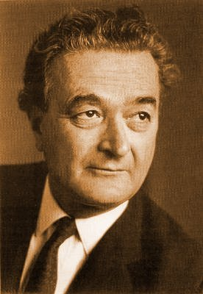
Atatürk asked Saygun to write another Opera suggesting the heroism of the Turks and Atatürk’s devotion to his country and people. The second opera is called “TAŞBEBEK”. In that very same year Saygun’s career was marked as the musical “voice” of the newly founded republic of Turkey. He was now the musical symbol of his country.
In 1936 he accompanied Bela Bartok on his travels around the country.
In 1939 he was invited back to Ankara to further promote Western musical activities and practices.
In 1946 Saygun’s international acclaim flourished with his oratorio Yunus Emre.
In 1958 he won the Stella Della Solidarite and the Jean Sibelius composition awards.

Slide 6
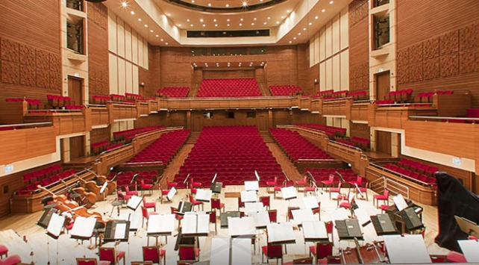
The Ahmet Adnan Saygun Art Center
Starting in 1972, he taught compositions and ethno musicology at the İstanbul Municipal Conservatory until his death in 1991.
The Ahmet Adnan Saygun center for music Research at Bilkent University in Ankara was founded where his original archives are kept.

Slide 7
His works were played by orchestra’s such as NBC Symphony Orchestra, Vienna Philarmonic, Vienna Symphony Orchestra, Berlin Symphony Orchestra, Munich Philarmonic, NRD Radiphilarmonic Hannover and numerous others.

Slide 8
His Works
Operas : Op.9 Özsoy, 1934 / Op.11 Taşbebek, 1934 / Op.52 Köroğlu, 1973…
Ballets : Op.17 A Forest Tale, 1939-1943 / Op.75 Legend Of Kumru 1986-1989.
Orchestral : Op.1 Divertimento, 1930 / Op.13 Magic Dance, 1934…
Vocal / Choral – Orchestral : Op.3 (tenor solo and male choir) Laments, 1932…
Concernante : Op.34 piano concerto No.1, 1952-1958…
Chamber : Op.20 Sonata (piano-violin), 1941…
Instrumental : Op.31 Partita For Cello, 1954…
Piano : Op.2 Suite For Piano, 1931…
Choral : Op.5 Folk Song, 1933…
Vocal : Op.32 Three Ballades, 1955 / Op.48 Four Melodies, 1977.

Slide 9
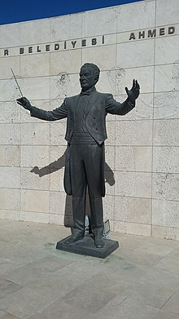
Statue Of Ahmet Adnan Saygun At Ahmet Adnan Saygun Art Center

Slide 10
Thank You For Your Attention Buket HEPKAN 12/A

