Slide 1
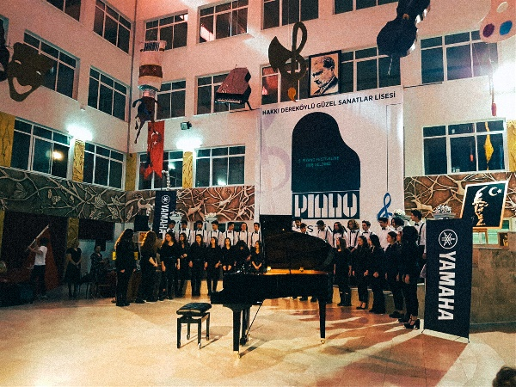
Hakkı Dereköylü Güzel Sanatlar Lisesi (Denizli Fine Arts High School)
Demir zengin
12-a

Slide 2
GENERAL INFORMATION
Denizli Fine Arts High School was officially founded in 1998 with two departments: music and visual arts training in Denizli, Turkey.
The students are between the ages of 14 and 18 are selected according to the special talent exam for both music and visual arts departments.
Stemming from its purpose of foundation, the school centers upon the inclusive aspect of art & music education.

Slide 3
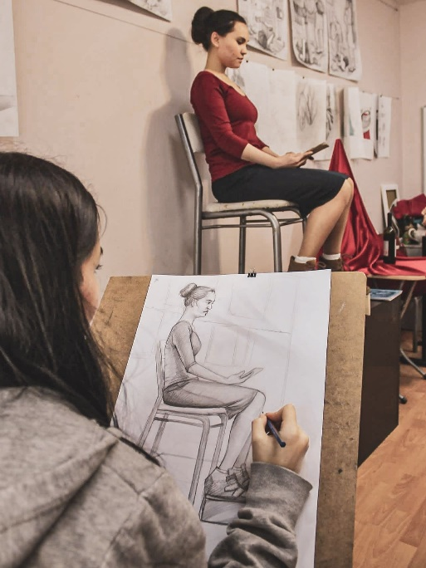
MUSIC AND VISUAL ARTS DEPARTMENTS
Piano lessons and (Bağlama lessons after 10th grade) are mandatory for all students in the Music department and each student chooses to receive education in one of the following: Violin, the Viola, the Cello, the Bağlama, the Guitar, the Contrabass, the Clarinet or the Flute.
The students of the Visual Arts department not only receive education in patterns, but also find the opportunity to work in two-dimensional and three dimensional art workshops, sculpture workshops and graphics workshops.

Slide 4
MAIN GOAL OF OUR SCHOOL
The mission of our school is to make our institution a center of culture and art in Denizli Province contributing to development of universal art.
The main aim of school activities is to raise individuals who can express themselves through visual arts and music, revealing and improving their abilities inside and respecting universal human values.

Slide 5
THAT’S ALL!
THANK YOU FOR COMING!
WE HOPE YOU ALL HAVE A GREAT WEEK!

