Slide 1
Erasmus + project “Developing professional knowledge, skills, and competence for music students”
Klaipedos Stasio Šimkaus konservatorija, Liepojos muzikos, mokslo ir dizaino vidurinė mokykla, Denizli dailės vidurinė mokykla
2019 - 2022

Slide 2
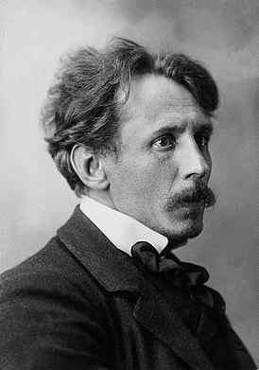
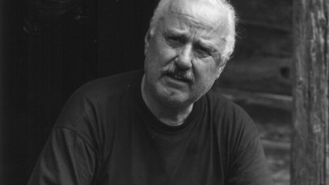
Bronius Kutavičius ir Mikalojus Konstantinas Čiurlionis

Slide 3
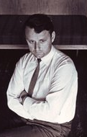
Bronius Kutavičius
Bronius Kutavičius (13 September 1932 – 29 September 2021) was a Lithuanian composer and academic composition teacher. He wrote numerous oratorios and operas, often inspired by ancient Lithuanian polytheistic beliefs and music. He also composed film scores, orchestral works and chamber music.

Slide 4
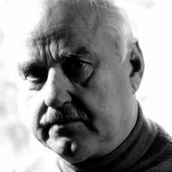
Music style
Bronius Kutavičius is one of the most outstanding musicians in Lithuania.
His creative work goes far beyond the boundaries of puree music and encompasses a wide cultural context, revealing layers of the history of nations going back to the beginnings of time, giving material form to the pure archetypes of mythic and religious.

Slide 5
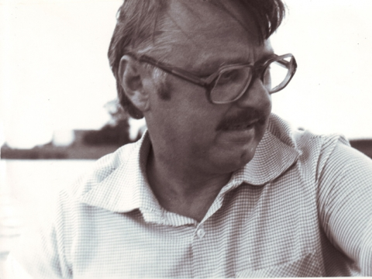
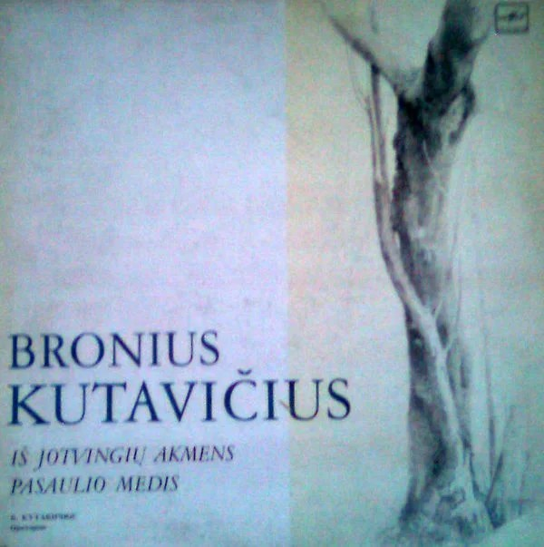
Kutavičius's work can appear to resemble early European (post)minimalism, but sounds completely different.
His 'pagan minimalism' is steeped in the archaic forms of Lithuanian ethnic music.

Slide 6
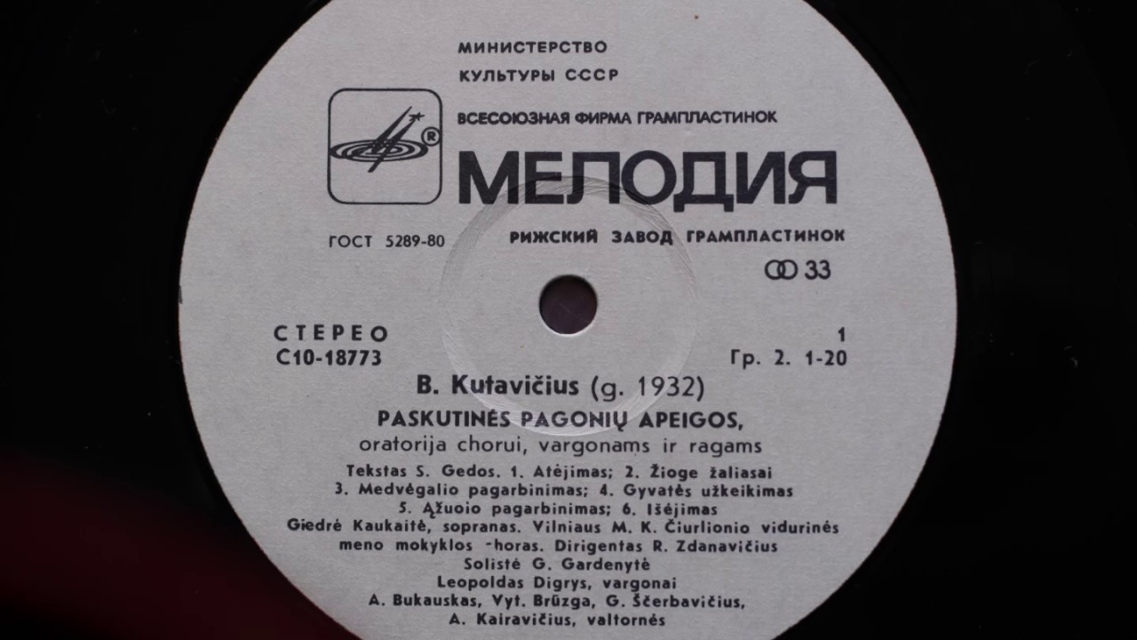
Music
Pagan rites:
https://youtu.be/jj_H-GGQNUU
Dzukish variation:
https://youtu.be/KBAn4pW6izA

Slide 7
Mikalojus Konstantinas Čiurlionis
Lithuanian artist and composer Mikalojus Konstantinas Čiurlionis (1875-1911), a unique figure in the history of European arts, has left a profound imprint on Lithuanian culture.

Slide 8
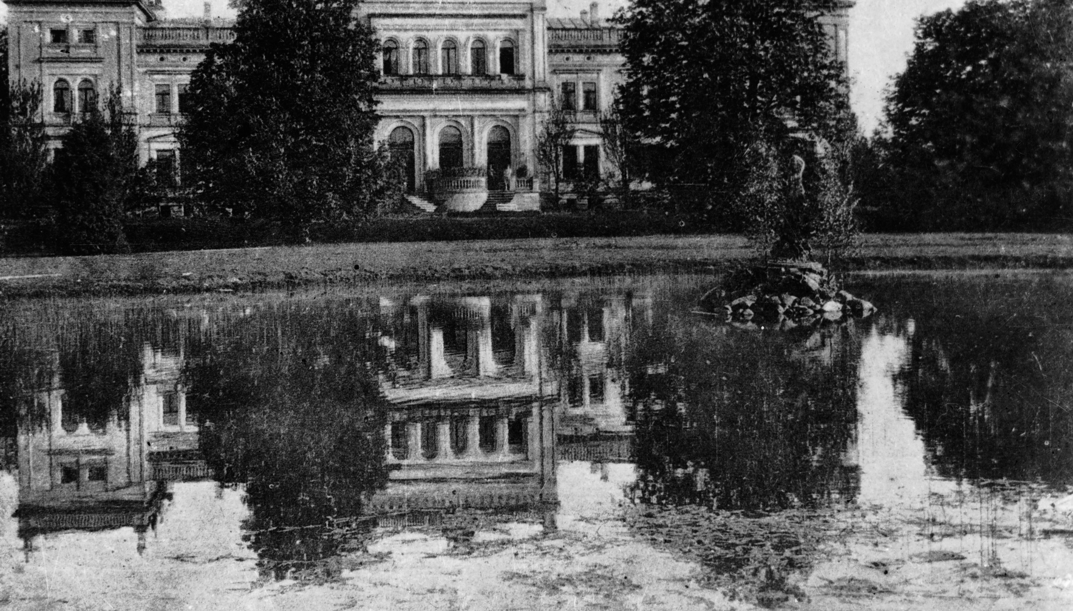
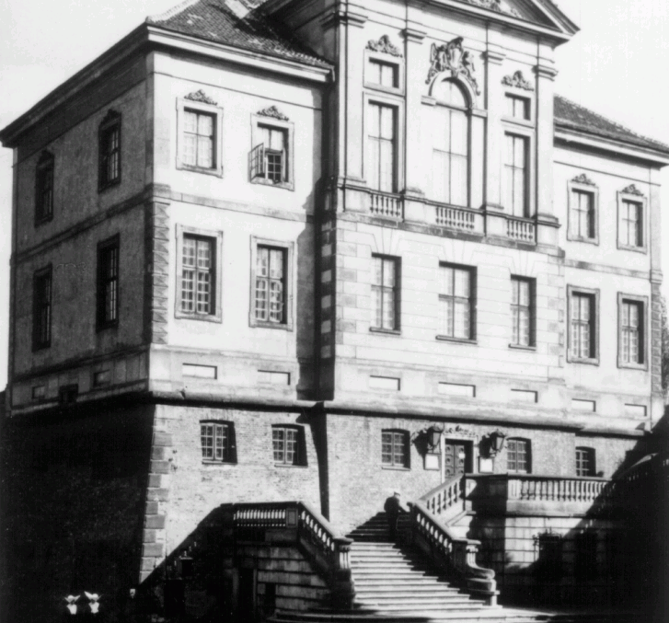
Studies
Notes from his study years at the Warsaw Institute of Music show his interest in geology and history, chemistry and geometry, physics and astronomy, astrology and ancient mythology, dead and modern languages, philosophical ideas of antiquity and modernity, eastern and western religions.On the other hand, his active involvement in the Lithuanian national movement and his idealist self-sacrifice for the sake of artistic ideals show him as a typical artist of the Romantic mold.

Slide 9
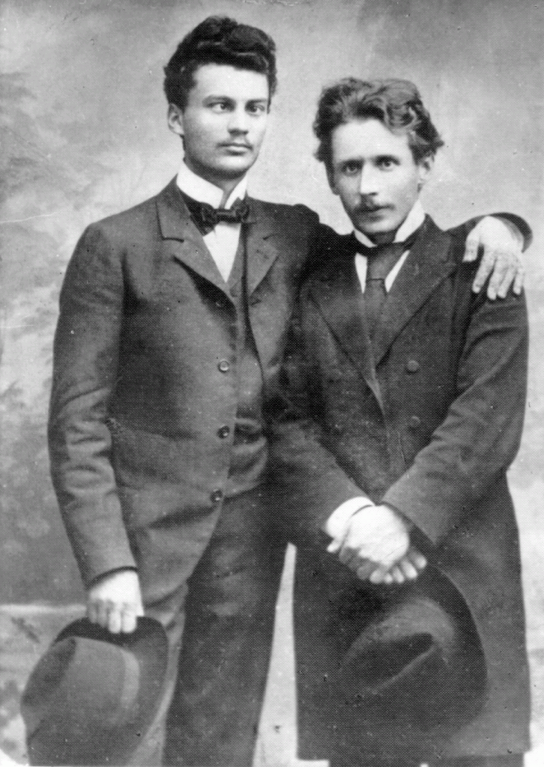
Judging by the breath of his artistic activities and diverse interests, Čiurlionis can be seen as a truly Renaissance individual. Over a short, mere decade-long career, he composed nearly four hundred musical compositions, including two large-scale symphonic poems, an overture, two piano sonatas, a string quartet, and a cantata for chorus and orchestra.

Slide 10
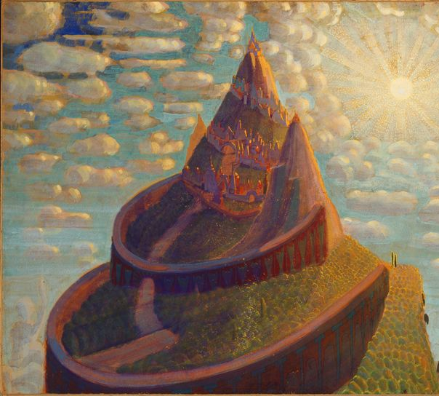
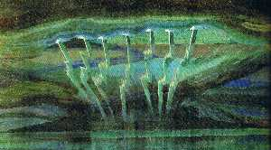
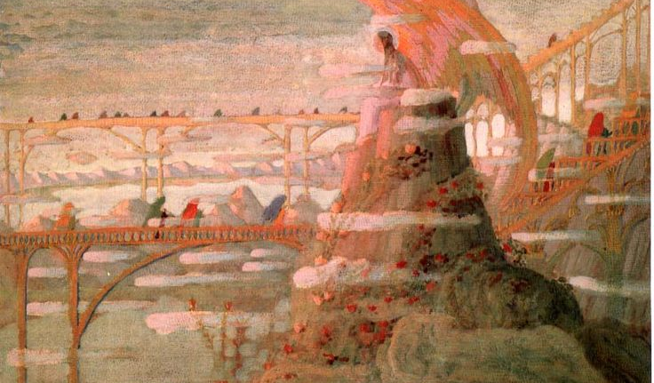
Paintings

Slide 11
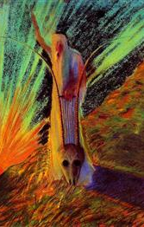
Why Čhiurlionis is important to Lithuania
During his short life, Čiurlionis managed to be at the heart of the creation of the Lithuanian Artists Union and actively organized and participated in the first three exhibitions of Lithuanian artists, organized and directed Lithuanian Choruses in Warsaw, Vilnius, and St. Petersburg, and was the first Lithuanian professional composer not only to take interest in Lithuanian folk songs, but to collect and publish them. His passionate approach to life is perhaps best summarized by his refusal to accept an offered safe teaching position at the Warsaw Institute of Music, and his declaration in a letter to his brother that he intends “to dedicate to Lithuania” all of his “past and future works.”

Slide 12
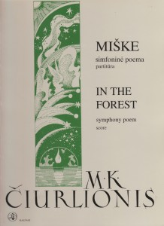
Čhiurlionis music
In the forest: https://youtu.be/MzEH7xrmflg
Four Preludes: https://youtu.be/0hhQnK2xcXc

Slide 13
THANKS FOR YOUR ATTENTION

