Slide 2
Notes:
Latvia is a country in Northern Europe, on the eastern shore of the Baltic Sea. One of the 3 Baltic States countries. The area of the country is 64,589 km2. Our country borders in the North with Estonia, in the east with Russia, in south-east with Belarus, in the south with Lithuania, in the west by the Baltic Sea, and here (shown in presentation) by the Gulf of Riga.

Slide 3
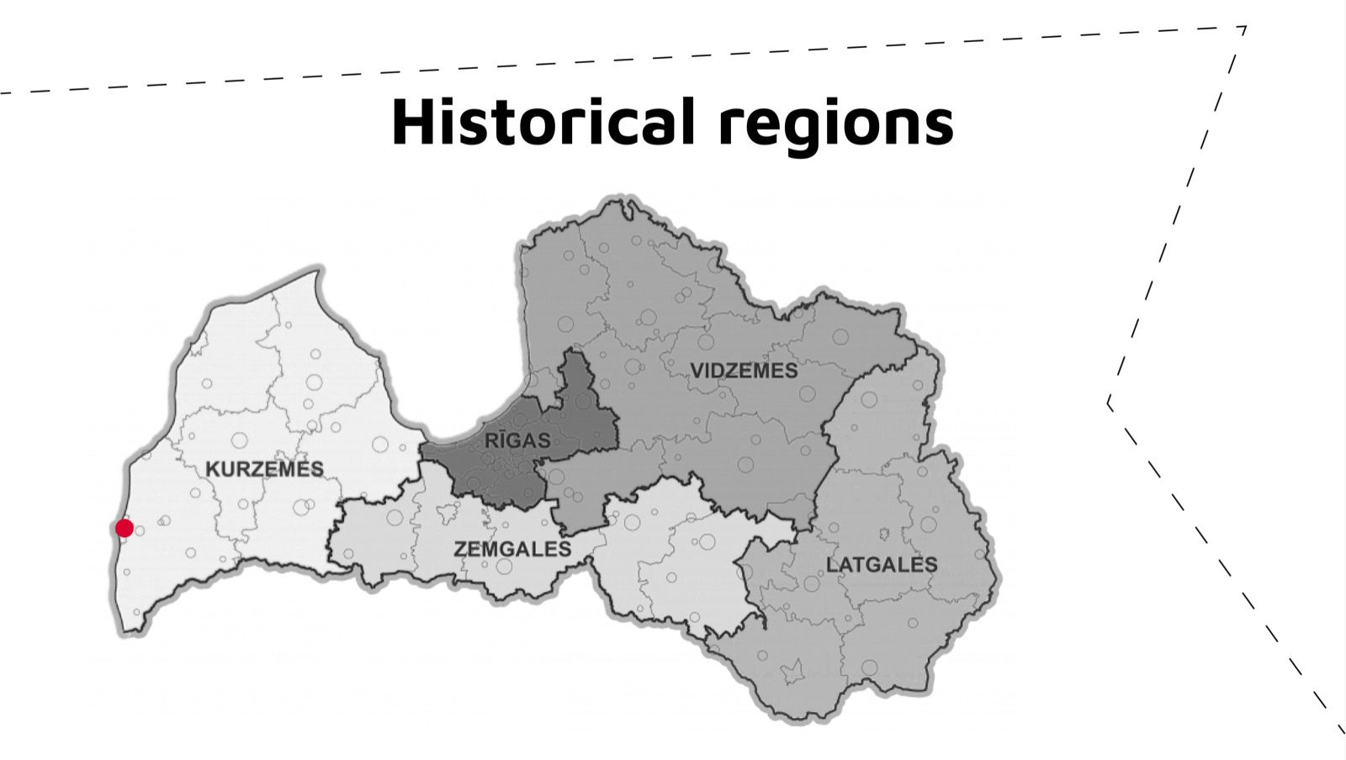

Slide 7
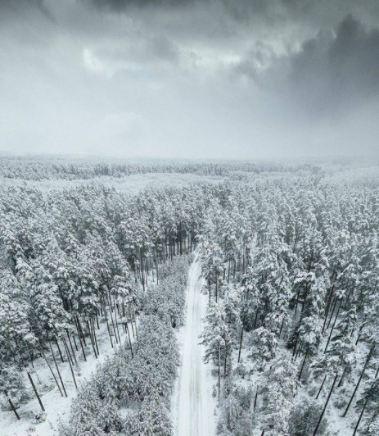
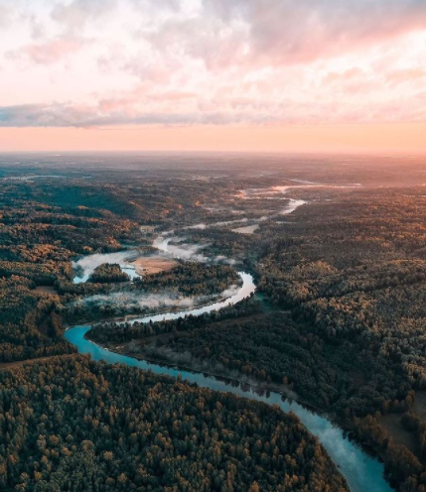
Notes:
53% of the territory of Latvia is covered by forests. Last year's research revealed that among EU countries, Latvia ranks 5th in terms of the percentage of forest area in the country.

Slide 12
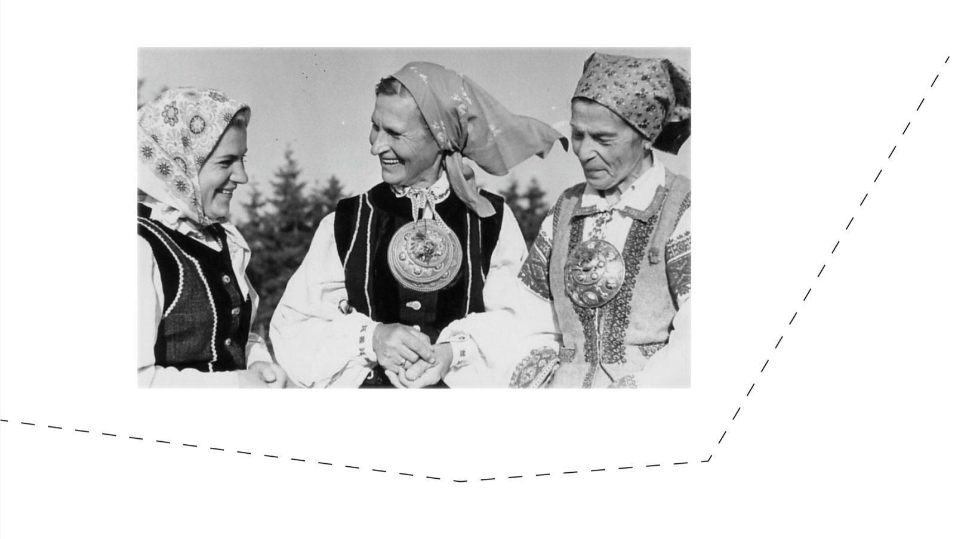

Slide 13
Pievienot tekstu

Slide 33
Teşekkürler!
Ačiū!

