Slide 1
Music in Turkey

Slide 2
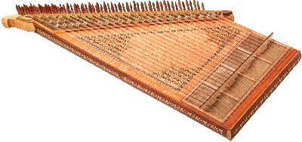
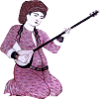
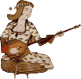
Outline of our Presentation
Some Basic Turkish Music Instruments
Some examples from Classical Turka Music
Ottoman Mehter Band
Important World Renowned Artists and composers in Turk Music and Turkish Folk Music
Some examples from Turk Folk And Pop Music

Slide 3
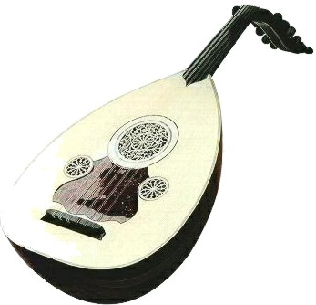
Some Turkish Musıc Instruments
Some Turkish Musıc Instruments
KANUN ( King)
Its sound range is from three and a half to eight. The performer sits on a chair and lays the Kanun flat on his knees, playing it with small ivory plectra placed on the index fingers of both hands. Recently, some experts have played the instrument on a small table to produce a denser sound.
UD (Queen)
Ud İs accepted as the queen of classical Turk music ınstruments.
Ud and Kanun are coherrent instruments. They are a good pair together.

Slide 4
KUDUM
Kudum is a small double kettle drum with the copper cup covered in camel or sheep skin and played with a pair of sticks called "Zahme".

Slide 5
NEY
The Ney is an important instrument in Classical Turkish Music and especially in Mevlevi Music which adopted the Ney as their main instrument in the Sema

Slide 6
A snapshot from Sema

Slide 7
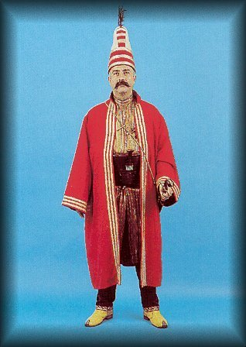
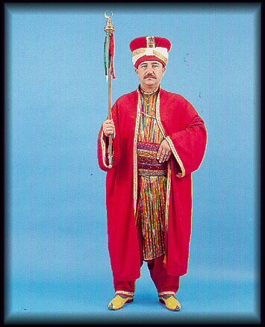
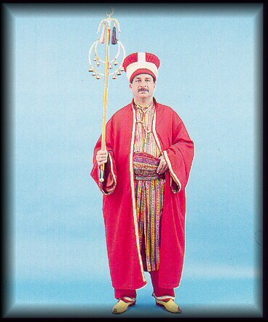
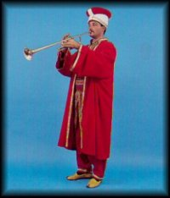
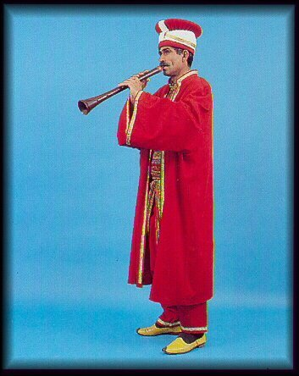
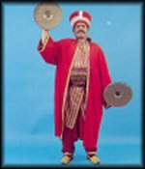
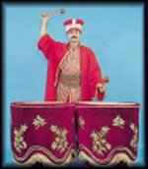
OTTOMAN MEHTER BAND

Slide 8
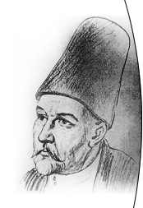
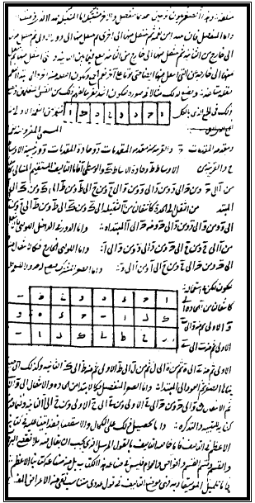
İsmail Dede Efendi
Famous Grand Master of Turk
Classical Music Forms
Ebced is a kind of nota
system in Turk Music

Slide 9
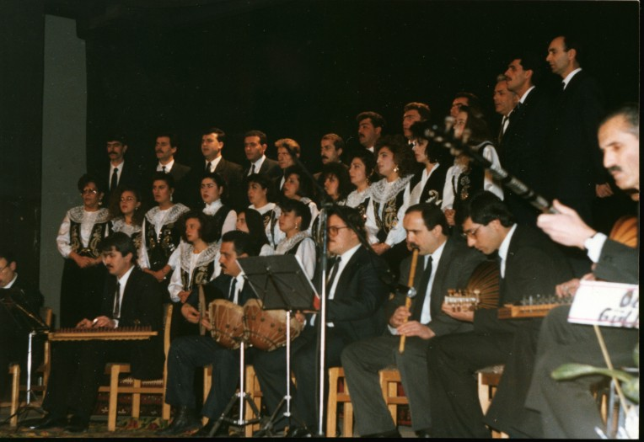
Examples from Turkish music
Notes:
kalamış

Slide 10
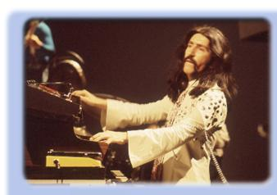
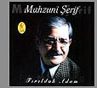
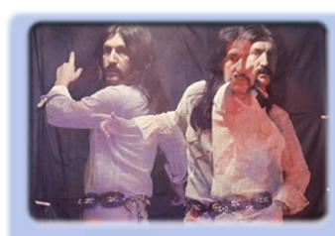
Famous Turk Musicians

Slide 11
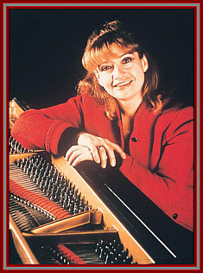
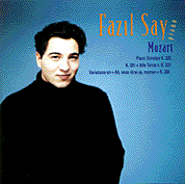
Famous Turk Pianists
İdil Biret

Slide 12
Summary of the presentation
In this presentation we mainly focused on this topics
Some Basic Turkish Music Instruments
Some examples from Classical Turka Music
Ottoman Mehter Band
Famoous Artists and composers in Turk Music and Turkish Folk Music
Some examples from Turk Folk And Pop Music

Slide 13
Thanks for watching

